Slide 1


WEARABLE IOT DEVICES
SRI SIDDHARTHA ACADEMY OF HIGHER EDUCATION
(DEEMED TO BE UNIVERSITY)
Accredited A⁺ Grade by NAAC
SRI SIDDHARTHA INSTITUTE OF TECHNOLOGY
(A Constituent College of SSAHE)
Maralur, Kunigal Road, TUMAKURU-572105
DEPARTMENT OF MASTER OF COMPUTER APPLICATIONS
2023 – 24
TECHNICAL SEMINAR-I
Presented by :
Mr. SYED SADATH S
23MCA53
I Semester, MCA
SSIT, Tumakuru

Slide 2
Agenda
Introduction to Wearable IoT
Applications of Wearable IoT Devices
What are Wearable IoT Devices?
Benefits of Wearable IoT Devices
Disadvantages of Wearable IoT Devices
Summary
Bibliography

Slide 3
Introduction to Wearable IoT
Wearable IoT (Internet of Things) devices are clearly gadgets or sensors that can be wear by users to collect data about their health, activity levels, environment, or other aspects of daily life. These devices are typically connected to the internet, allowing them to transmit data to other devices or cloud-based platforms for analysis and monitoring
The devices are hands-free gadgets with practical uses, powered by microprocessors and enhanced with the ability to send and receive data via the Internet
wearable IOT devices commonly used as ,fashion technology, wearable devices ,fashion electronics are clothing's and accessories
Activity tracker was the first wearable iot device which was launched in 2009.

Slide 4
Applications of Wearable IoT Devices
Health and Fitness
Medical
Safety and Security
Sports and Entertainment
Education
Military and Defense
Smart Home Integration

Slide 5
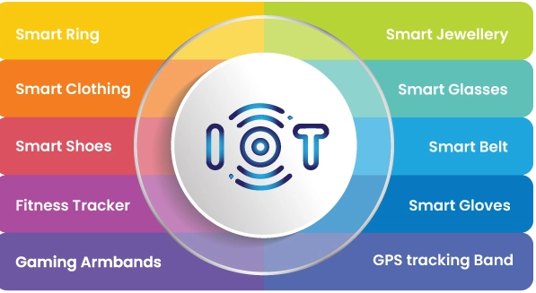
What are Wearable IoT Devices?
Top 10 Wearable IoT Devices

Slide 6
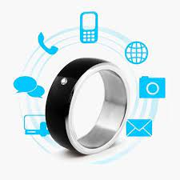
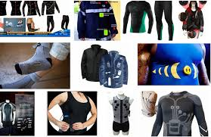
1.smart ring
Smart rings pair with a smartphone or tablet and can provide notifications, control music playback, and even be used to make contactless payments. It connected to mobile or tablet through Bluetooth
2.Smart clothing
Smart clothing is a wearable technology that provides all body or health-related information to the user.
It can detect temperature, respiration rate, heart rate and other health-related information.
These can be used widely for military purposes.

Slide 7
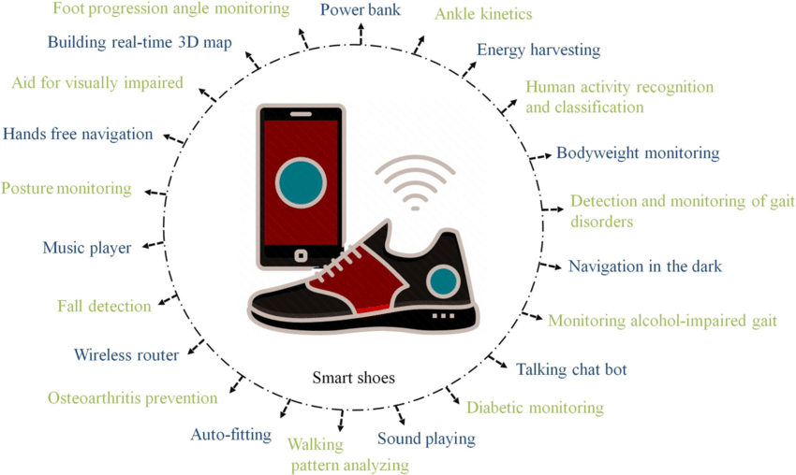
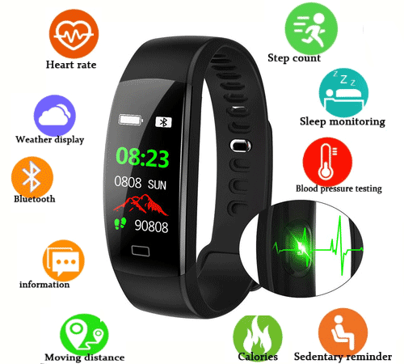
3.Smart Shoes
The smart shoe also tracks calories, steps, posture, fatigue and other health parameters to prevent injuries.
Smart shoe is connected with the mobile phone application via Bluetooth to provide real-time and personalized coaching.
4.Fitness Tracker
The fitness tracker can track the calories burned, weight gained, distance travelled, blood pressure and heart rate.
Some fitness trackers can even monitor sleep and indicate whether the user has an adequate level of sleep every day.

Slide 8
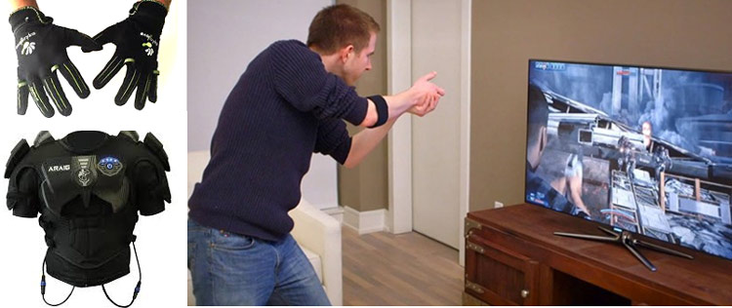
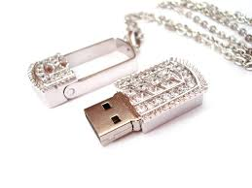
5.Gaming Armbands
This armband has built-in sensors which detect the movement of the arm, muscle and fingers and replicate those movements in the virtual character in the game
The wearable IoT devices for gaming are focused on enhancing the user’s gaming experience.
6.Smart Jewellery
Smart jewellery helps in detecting stress levels and generates recommendations on the mobile phone to relax the mind.
It can also work as a sleep monitoring device or an activity tracker.

Slide 9
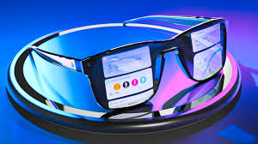
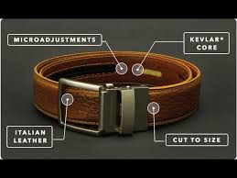
7.Smart Glasses
Smart glasses widely being used for security and healthcare purposes.
These glasses can also be used for navigation, indoor or outdoor sports activities and hand-free cooking assistance.
8.Smart Belt
smart belt is equipped with a gyroscope, an accelerator and small sensors to help determine how much you have been moving or whether or not you need to be more active.
smart belt which can visualize the potential weight gain and can monitor the user’s activity, for instance, sitting habits, calories and step count.

Slide 10
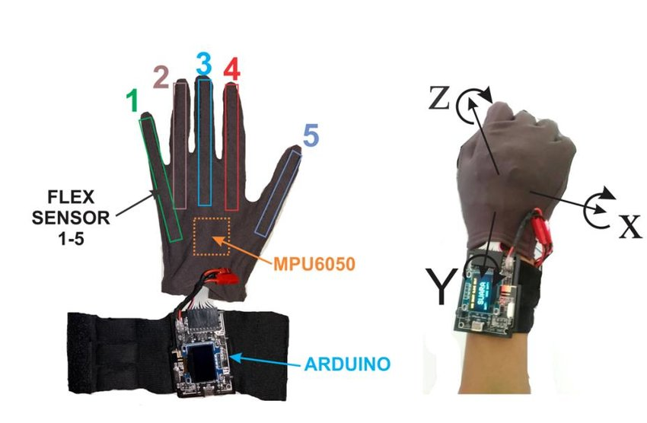
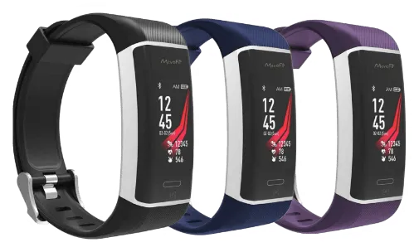
9.Smart Gloves
Majorly, smart gloves have been designed to enable users to manipulate virtual objects by touching them more directly and intuitively.
10.GPS Tracking Band
GPS Tracker used to track the exact location of the Humans ,Animals or Any other objects Location.
This helps the parents to keep the track of their children and immediately get alert on a mobile phone application whenever their child is in trouble.

Slide 11
Benefits of Wearable IoT Devices
improved health and fitness outcomes
Real-time monitoring and alerts
Enhanced user experience and convenience
Data-driven insights for better decision-making

Slide 12
Disadvantages of Wearable IoT Devices
Privacy Risks
Limited Battery Life
Connectivity Issues
High Cost
Health Concerns
Maintenance Needs

Slide 13
Summary
The wearable IoT devices are not limited to the aforementioned examples, but from the smart working of these devices, it can be expected that with IoT, the future will be thought-provoking.
Wearable IoT devices will continue to evolve and will make human life much easier._x000b_

Slide 14
Bibliography
https://chat.openai.com/
https://gemini.google.com/
https://www.slideshare.net/anjalipaurush/wearable-tech-ppt/
https://www.conurets.com/top-10-wearable-iot-devices-in-2022/

Slide 15
THANK YOU

